Slide 1
EternaBrain
Rohan Koodli
Eterna Developers
8/11/2017

Slide 2
Overarching Goal: Generate sequence for given secondary structure

Slide 3
Current algorithms are inadequate for solving such problems

Slide 4
Eterna crowdsources RNA folding to the public
Humans are good, can we learn from them?
Use vast dataset of Eterna player solutions to train a neural network

Slide 5
Objective
Predict nucleotide sequence given a secondary structure using Eterna data and machine learning

Slide 6
Machine Learning Background

Slide 7
Artificial Neural Network
Machine learning that models the human brain
Gives certain neurons weights
Backpropagation will calculate the errors
Minimize cost

Slide 8
Convolutional neural network (CNN)
Used in image recognition and AlphaGo
Looks at nearest neighbors of inputs and creates feature maps

Slide 9
Monte Carlo Tree Search (MCTS) & Reinforcement Learning
Used in game-playing AI

Slide 10
My Work

Slide 11
Training Data

Slide 12
Training data
Don’t train on simply the final base sequence of solved puzzles
Train on how the players got to the final base sequence (their moves)
Give neural network same information players are given via the Eterna interface

Slide 13
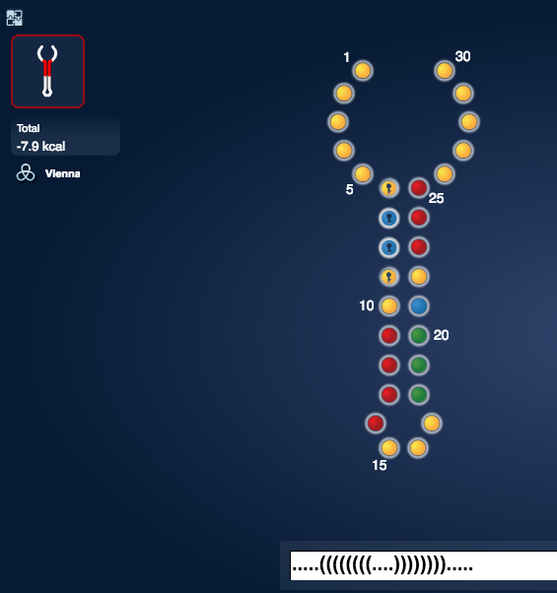
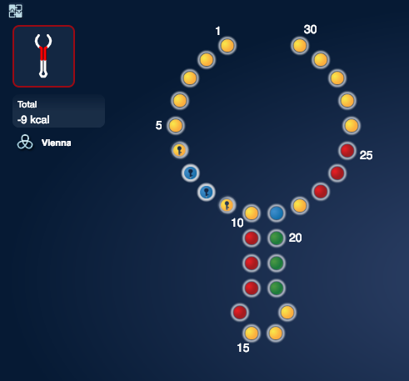
Target energy
Current energy
Locks
Base sequence
Current structure + pairmap
Target structure + pairmap

Slide 14
What the features look like
[1,2,2,3,1,1,1,4,1,1,4] – nucleotide sequence
[1,2,2,2,1,1,1,3,3,3,1] – current structure
[2,2,2,2,1,1,1,3,3,3,3] – target structure
[1.4,0,0,0,0,0,0,0,0,0,0] – current energy
[2.2,0,0,0,0,0,0,0,0,0,0] – target energy
[-1,9,8,7,-1,-1,-1,3,2,1,-1] – current pairmap
[10,9,8,7,-1,-1,-1,3,2,1,0] – target pairmap
[1,1,1,1,2,2,2,1,1,1,1] – locks

Slide 15
Features for base predictor
[1,2,2,3,1,1,1,4,1,1,4] – nucleotide sequence
[1,2,2,2,1,1,1,3,3,3,1] – current structure
[2,2,2,2,1,1,1,3,3,3,3] – target structure
[1.4,0,0,0,0,0,0,0,0,0,0] – current energy
[2.2,0,0,0,0,0,0,0,0,0,0] – target energy
[-1,9,8,7,-1,-1,-1,3,2,1,-1] – current pairmap
[10,9,8,7,-1,-1,-1,3,2,1,0] – target pairmap
[1,1,1,1,2,2,2,1,1,1,1] – locks
[0,0,0,1,0,0,0,0,0,0,0] – location

Slide 16
Initial Approaches and Issues

Slide 17
Base and location independent
Didn’t feed in location into base predictor
Players generally select what base to mutate based on where in the puzzle they’re solving
This information is not explicitly encoded in the Eterna interface
Keeping base and location independent did not provide the neural net with the information players are given

Slide 18
Training on everybody
12 puzzles from progression, all players, 1.8M moves
Limited by computational power (took few days to prep data)
Little good variance
Too few puzzles = not enough breadth of puzzle types to generalize well
Too much bad variance
Too many players = wide range of puzzle solving styles could confuse neural net

Slide 19
Deep neural net
Used a standard, feed-forward deep neural network
Convolutional network would look at nearest neighbors of sequence or structure
Useful as base selection depends on local structure (stacks, loops, hairpins, etc.)

Slide 20
Changes made
Used a CNN
Selected only experts and used a wider range of puzzles
Fed in location of mutation into nucleotide predictor

Slide 21
Finalized Model

Slide 22
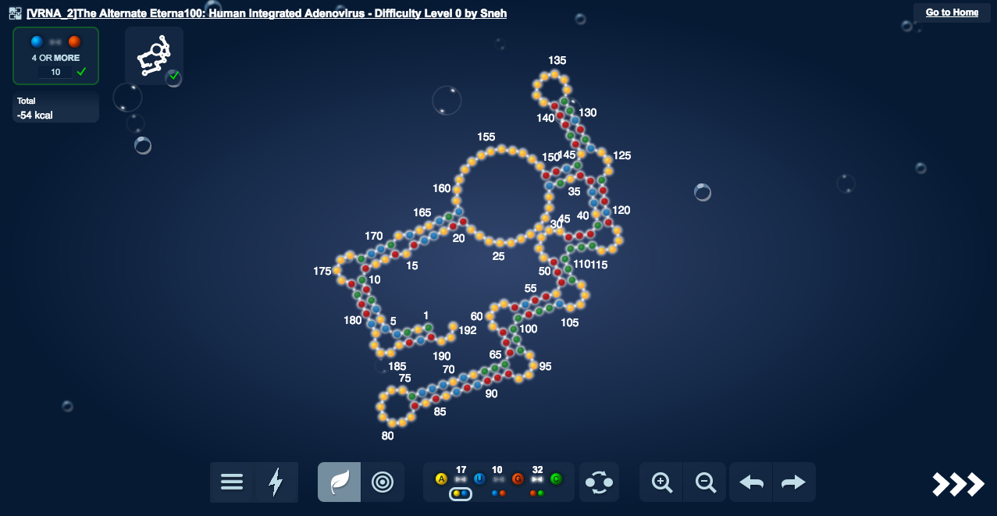
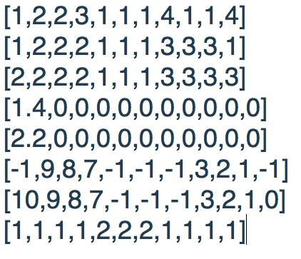
Overview

Slide 23
Neural Net Architecture
92 puzzles, 30K moves, 70 experts (solved over 3000 puzzles each)
Convolutional neural net, 10 convolutional layers (with pooling), 4 fully-connected, 150 epochs, 0.1 dropout, sigmoid, Adam Optimizer
2D convolutions (height 8/9 to match number of features, 8/9 nearest neighbors)
But essentially 1D convolutions with 8/9 nearest neighbors
Stochastically choose moves based on neural net probabilities

Slide 24
Depth 1 Monte Carlo Tree Search
Single-action playout (SAP) which goes through each individual base and mutates it to A, U, G, or C and sees which brings it closer to target structure, corrects base pairings, and other minor fixes

Slide 25
Results

Slide 26
Accuracies of neural net predicting player moves (so far)
baseCNN
Train Accuracy: 0.75
Test Accuracy: 0.51
locationCNN
Train Accuracy: 0.31
Test Accuracy: 0.34

Slide 27
Why the SAP?
So that it gets better (AlphaGo approach)
The stochastic move selector helped the neural net get unstuck of probabilities were similar, but also would make dumb moves sometimes
[0.6, 0.05, 0.3, 0.05] # A, U, G, C
Would pick G 30% of the time
SAP would learn through trial-and-error and fix the CNN’s minor mistakes

Slide 28
Eterna100

Slide 29
Eterna100
✔️ = Solved
✖️ = Couldn’t solve

Slide 30
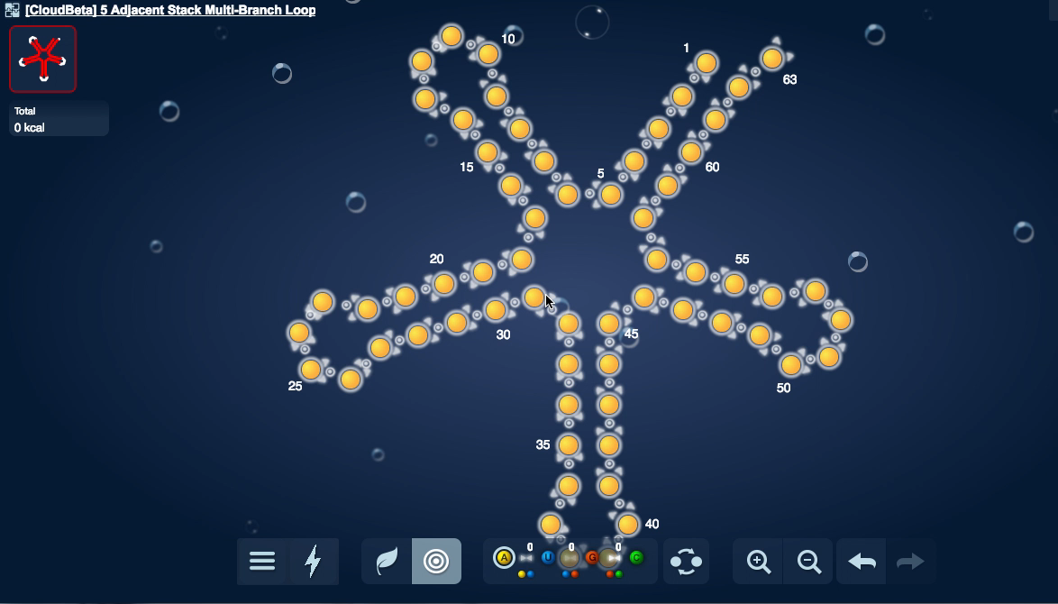
Playouts

Slide 31
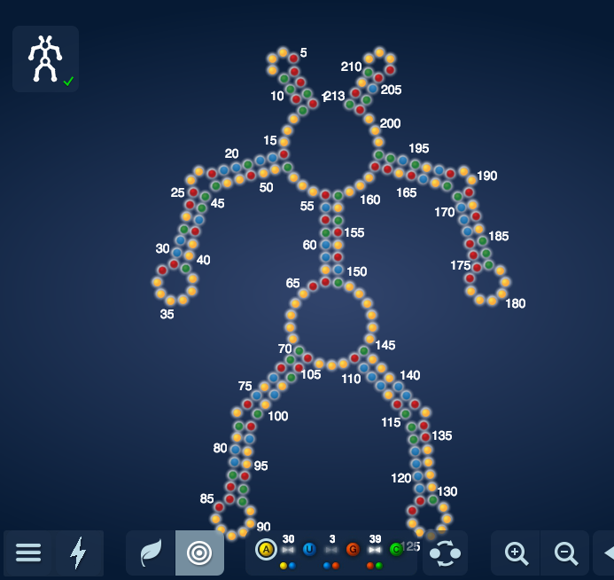
Puzzles Solved - Easy
Mat – Martian 2

Slide 32
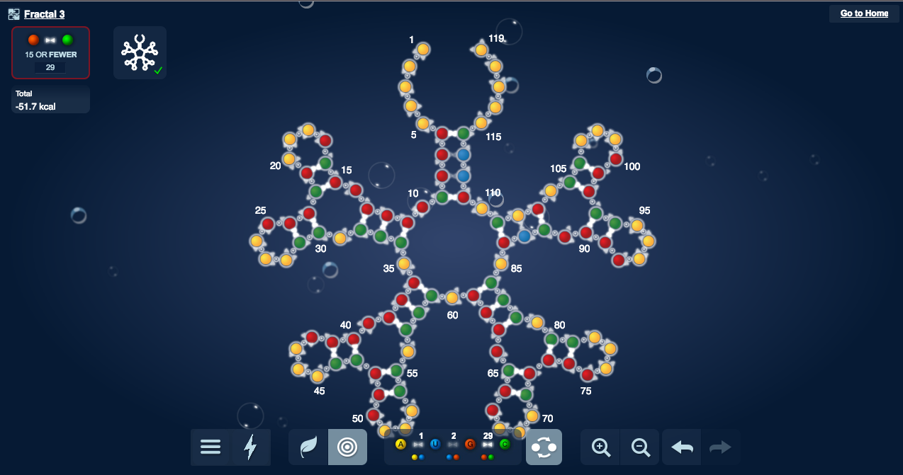
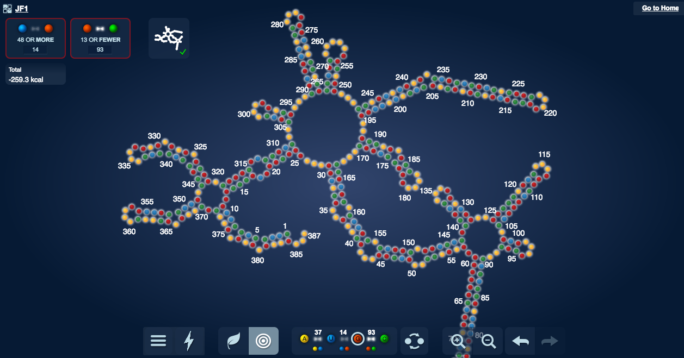
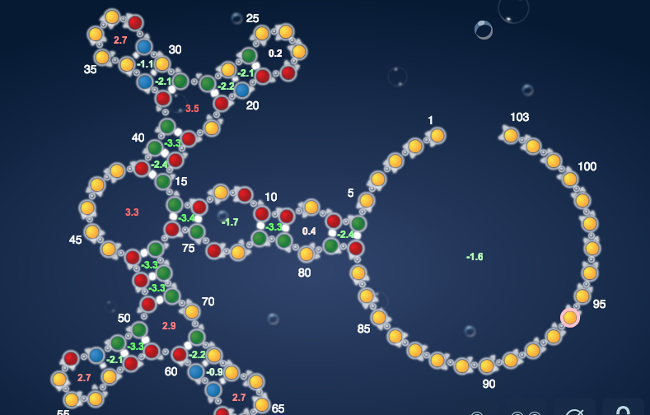
Puzzles Solved - Medium
Fractal 3
Water Strider
JF1

Slide 33
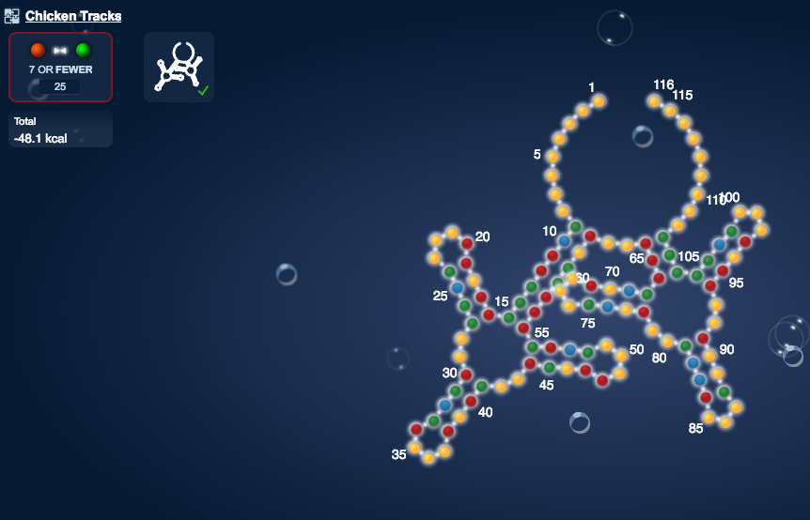
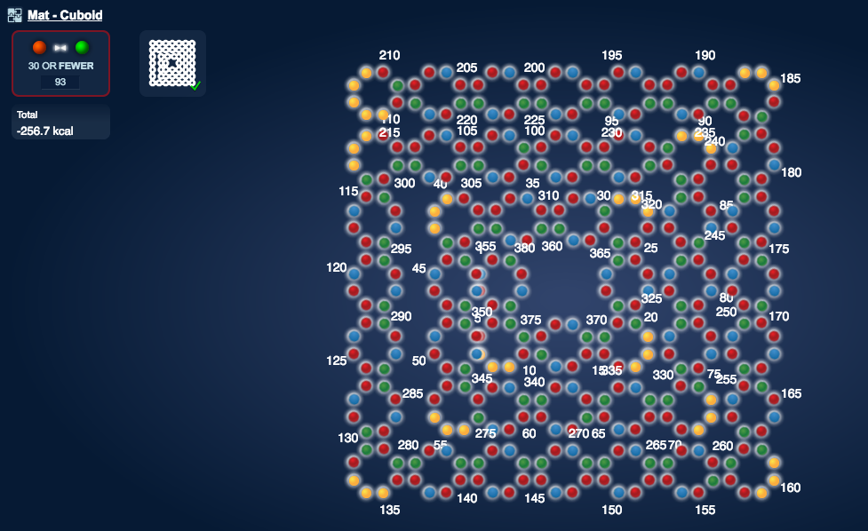
Puzzles Solved - Difficult
Chicken Tracks
Cuboid

Slide 34
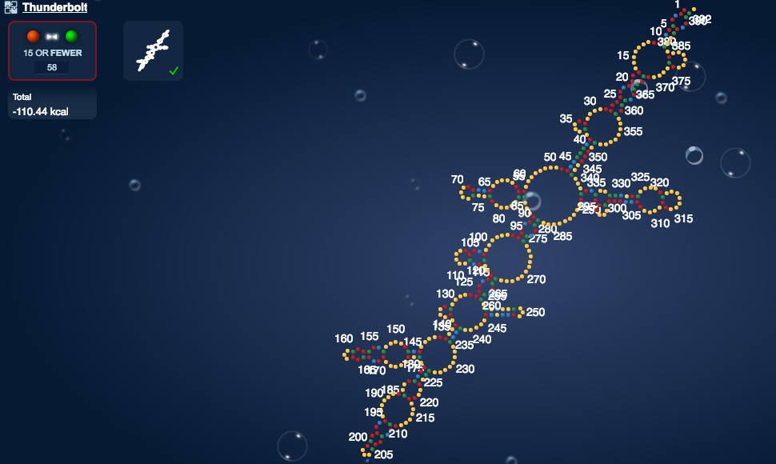
Puzzles Solved - Difficult
Thunderbolt

Slide 35
Comparison with EteRNABot

Slide 36
EternaBrain v/s EteRNABot

Slide 37
Conclusions

Slide 38
Conclusions
Eterna moveset dataset is useful and can be used for machine learning
Need multiple scripts to solve the puzzle
As CNN gets better and better, will become less reliant on SAP
Training on all players led to there being too much variance in solving strategies

Slide 39
Limitations of CNN
Stochastic move selector
Could not be precise enough to completely solve a puzzle
CNN provided a good starting sequence for the SAP, which could make more precise mutations at locations that weren’t folding correctly

Slide 40
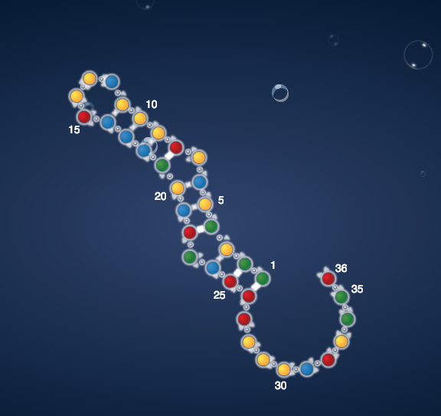
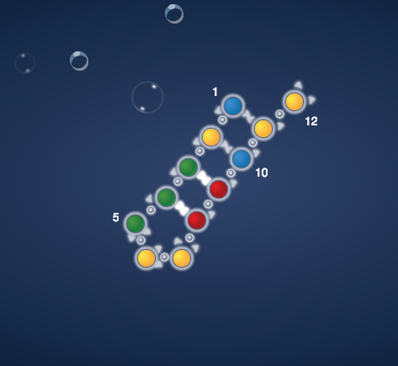
CNN could solve w/o SAP

Slide 41
Next Steps
Train on more puzzles and fewer experts
Make a hogbot
Vary hyperparameters (dropout, layers, layer size, etc.)
Fix bugs
Neuroevolution
Train on successful solutions

Slide 42
Acknowledgements
Ben Keep
Rhiju Das
Michelle Wu
Joe Yesselman
Das Lab
Eterna players
Jade Shi
Peter Eastman
Pande Lab

